Slide 1
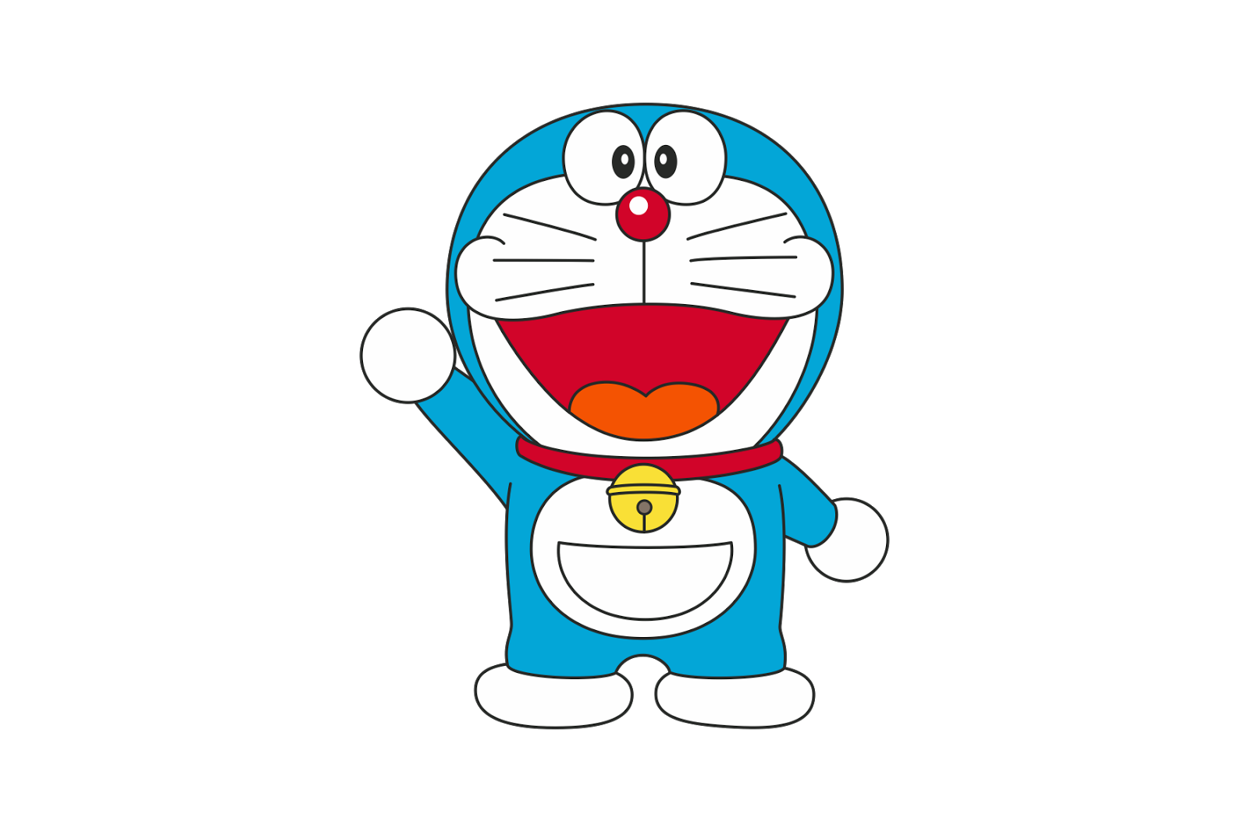
Computer GO
doraemon

Slide 2
iNTRODUCTION
Why study Computer Go?
Go is a complex board game that requires intuition, creative and strategic thinking.It has long been considered a difficult challenge in the field of artificial intelligence (AI) and is considerably more difficult to solve than chess. Many in the field of artificial intelligence consider Go to require more elements that mimic human thought than chess.

Slide 3
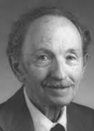
Mathematician I. J. Good wrote in 1965:
Go on a computer? – In order to programme a computer to play a reasonable game of Go, rather than merely a legal game – it is necessary to formalise the principles of good strategy, or to design a learning programme. The principles are more qualitative and mysterious than in chess, and depend more on judgment. So I think it will be even more difficult to programme a computer to play a reasonable game of Go than of chess.

Slide 4
Go=>ruLES
Basic Rules of GO
KO rule
Suicide
Komi
Scoring Rules

Slide 5
Go:BASIC rULES
Two players, Black and White, take turns placing a stone (game piece) of their own color on a vacant point (intersection) of the grid on a Go board.
Black plays first.
Vertically and horizontally adjacent stones of the same color form a chain
Vacant point adjacent to a stone is called a liberty for that stone

Slide 6
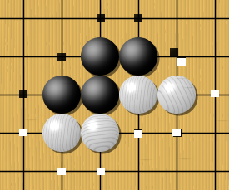
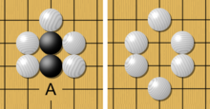
One black chain and two white chains, with their liberties marked with dots. Liberties are shared among all stones of a chain and can be counted. Here the black group has 5 liberties, while the two white chains have 4 liberties each.
If White plays at A, the black chain loses its last liberty. It is captured and removed from the board.

Slide 7

KO RULE
Players are not allowed to make a move that returns the game to the previous position. This rule, called the ko rule, prevents unending repetition.

Slide 8
Suicide
A player may not place a stone such that it or its group immediately has no liberties, unless doing so immediately deprives an enemy group of its final liberty. In the latter case, the enemy group is captured, leaving the new stone with at least one liberty.

Slide 9
Komi Rule
Because Black has the advantage of playing the first move, the idea of awarding White some compensation came into being during the 20th century. This is called komi, which gives white a 6.5-point compensation under Japanese rules (number of points varies by rule set).

Slide 10
Scoring rule
Area scoring (including Chinese)
A player's score is the number of stones that the player has on the board, plus the number of empty intersections surrounded by that player's stones.
Territory scoring (including Japanese and Korean)
In the course of the game, each player retains the stones they capture, termed prisoners. Any dead stones removed at the end of the game become prisoners. The score is the number of empty points enclosed by a player's stones, plus the number of prisoners captured by that player.

Slide 11
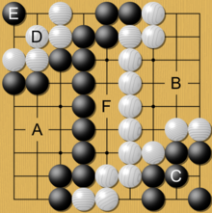
A simplified game at its end. Black's territory (A) + (C) and prisoners (D) is counted and compared to White's territory (B) only (no prisoners). In this example, both Black and White attempted to invade and live (C and D groups) to reduce the other's total territory. Only Black's invading group (C) was successful in living, as White's group (D) was killed with a black stone at (E). The points in the middle (F) are "dame", meaning they belong to neither player.

Slide 12
Computer GO : approach to the problem
One traditional AI technique for creating game playing software is to use a minimax tree search. This involves playing out all hypothetical moves on the board up to a certain point, then using an evaluation function to estimate the value of that position for the current player. The move which leads to the best hypothetical board is selected, and the process is repeated each turn.
While tree searches have been very effective in computer chess, they have seen less success in Computer Go programs. This is partly because it has traditionally been difficult to create an effective evaluation function for a Go board, and partly because the large number of possible moves each side can make each leads to a high branching factor. This makes this technique very computationally expensive.

Slide 13
Computer GO : approach to the problem
One major alternative to using hand-coded knowledge and searches is the use of Monte Carlo methods. This is done by generating a list of potential moves, and for each move playing out thousands of games at random on the resulting board. The move which leads to the best set of random games for the current player is chosen as the best move.
The advantage of this technique is that it requires very little domain knowledge or expert input, the trade-off being increased memory and processor requirements. However, because the moves used for evaluation are generated at random it is possible that a move which would be excellent except for one specific opponent response would be mistakenly evaluated as a good move.
The result of this are programs which are strong in an overall strategic sense, but are imperfect tactically
Besides Monte Carlo Method , Deep Learning is considered as one of the best algorithms which can succeed with a better rate than others

Slide 14
Minimalistic Go MCTS Engine

Slide 15
Michi aims to be a minimalistic but full-fledged Computer Go program based on state-of-art methods (Monte Carlo Tree Search) and written in Python. Our goal is to make it easier for new people to enter the domain of Computer Go, peek under the hood of a "real" playing engine and be able to learn by hassle-free experiments - with the algorithms, add heuristics, etc.
From :https://github.com/pasky/michi

Slide 16
Minimalistic Go MCTS Engine:OUR Project
Our project uses a 9x9 board game Go with the numbers 1-9 to mark the row and letters A-I to mark the columns of the board , using AI from Go engines sourced from https://github.com/pasky/michi
In this game, player 1 uses symbol (X) and player 2 uses symbol (O). We play this game by typing the coordinate which we desired with format (letter) (number).For example: A3, B1
In this game, it also shown the time that AI uses to think.

Slide 17
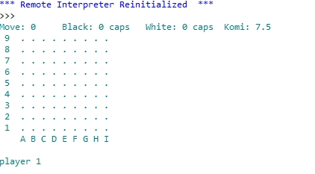
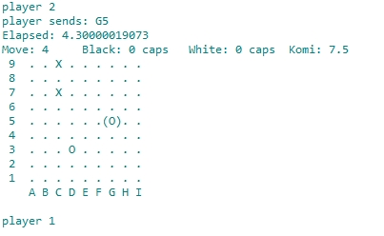
"Player 1" shows that it’s player 1 turn Player sends: shows us the coordinates sent by the player playing at that turn Elapsed time: How long the AI think(process time) Move: Show us how many turn has passed since the game began

Slide 18
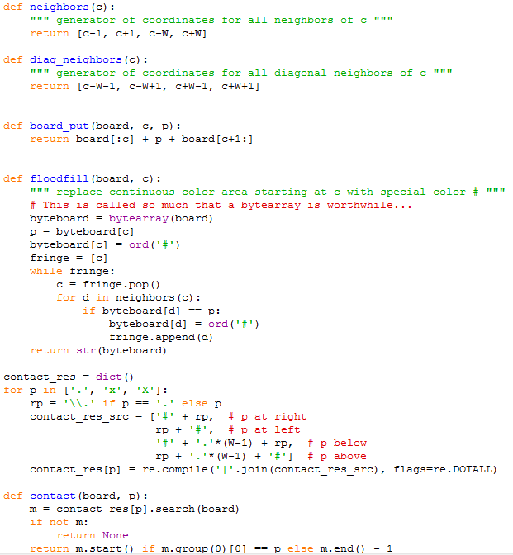
pengecekan posisi, terkepung atau tidak, serta perhitungan teritory

Slide 19
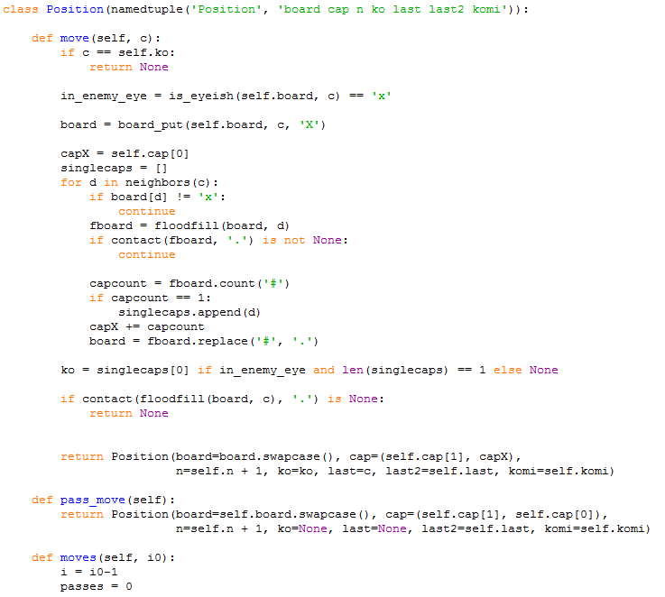
penempatan untuk koordinatnya serta jalannya game

Slide 20
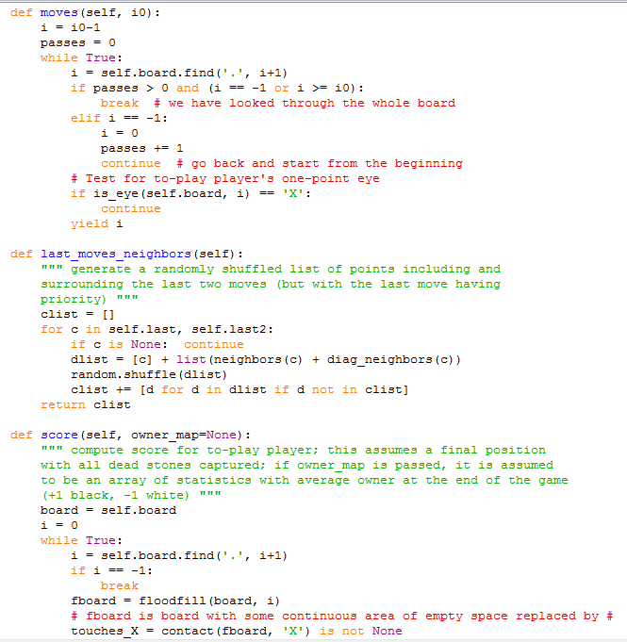
penempatan untuk koordinatnya serta jalannya game

Slide 21
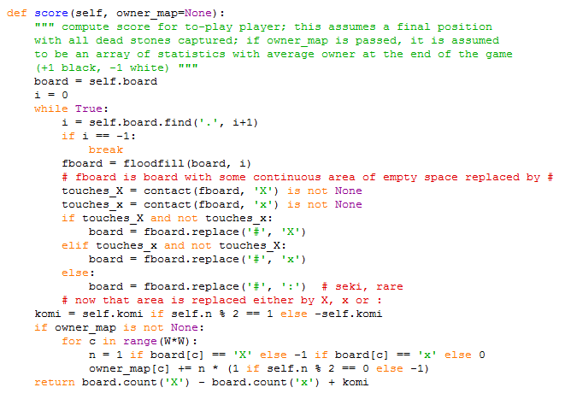
penempatan untuk koordinatnya serta jalannya game

Slide 22
penempatan untuk koordinatnya serta jalannya game

Slide 23
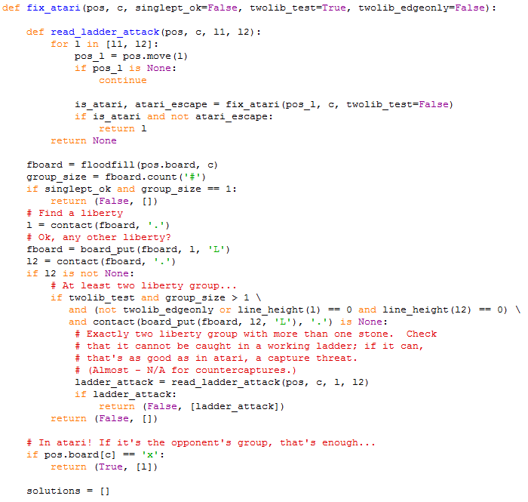
penempatan jika atari

Slide 24
perhitungan score

Slide 25
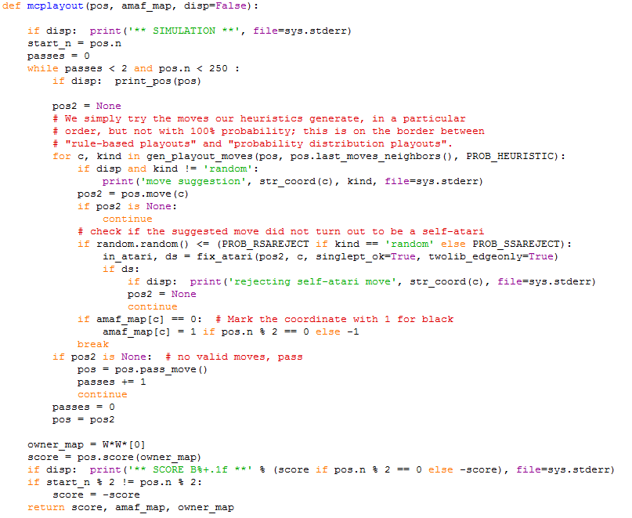
Monte Carlo

Slide 26
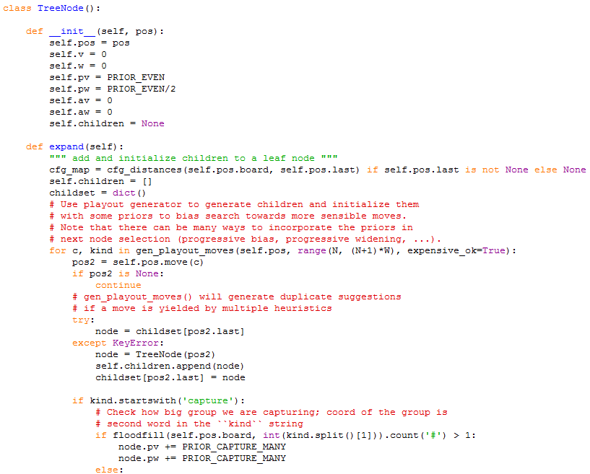
pemilihan tempat koordinat

Slide 27
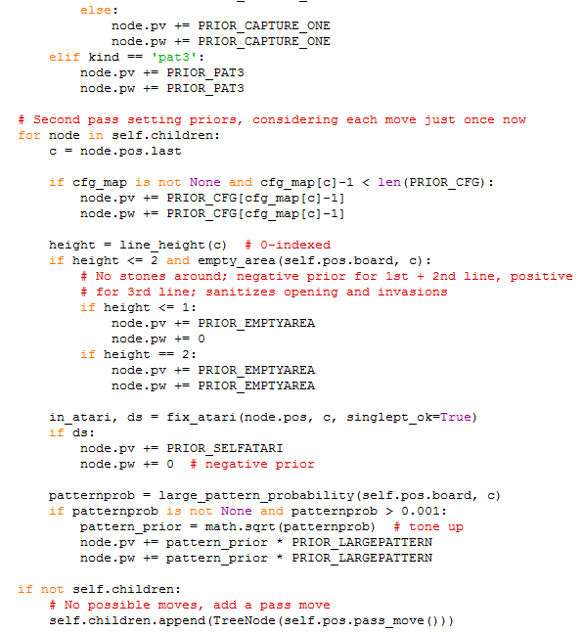
pemilihan tempat koordinat

Slide 28
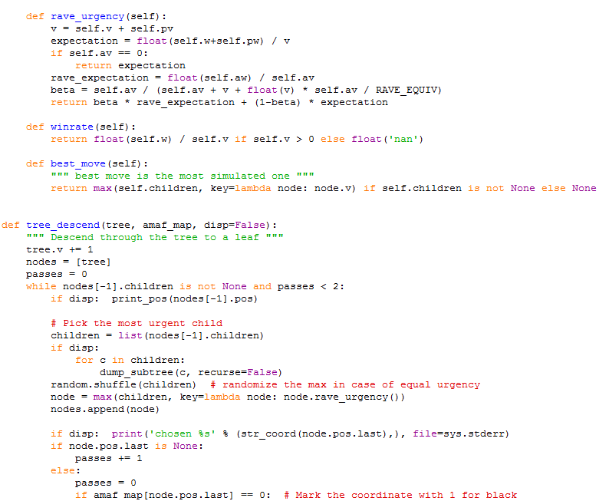
pemilihan tempat koordinat

Slide 29
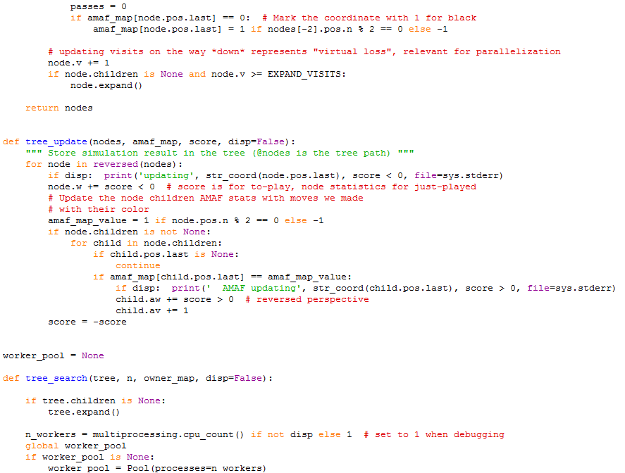
pemilihan tempat koordinat

Slide 30
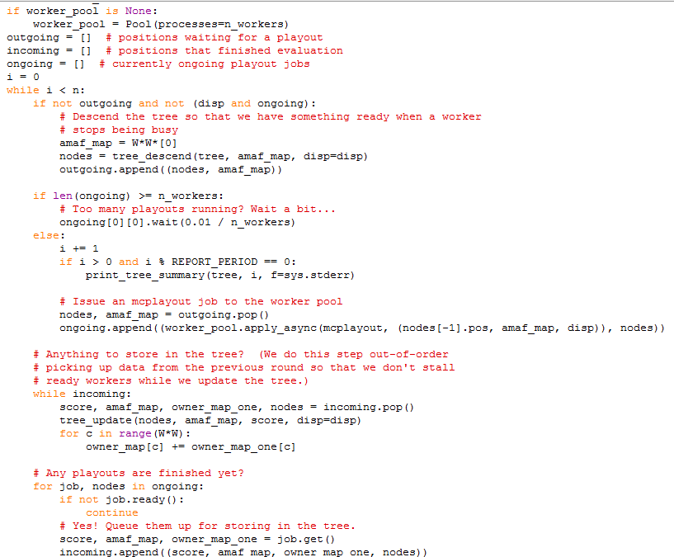
pemilihan tempat koordinat

Slide 31
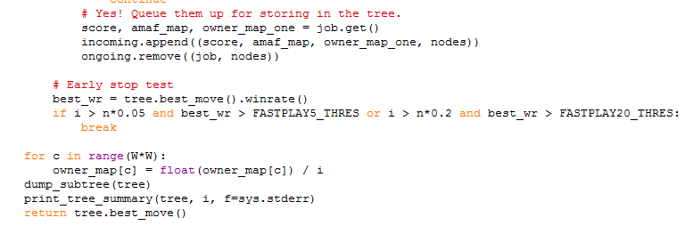
pemilihan tempat koordinat

Slide 32
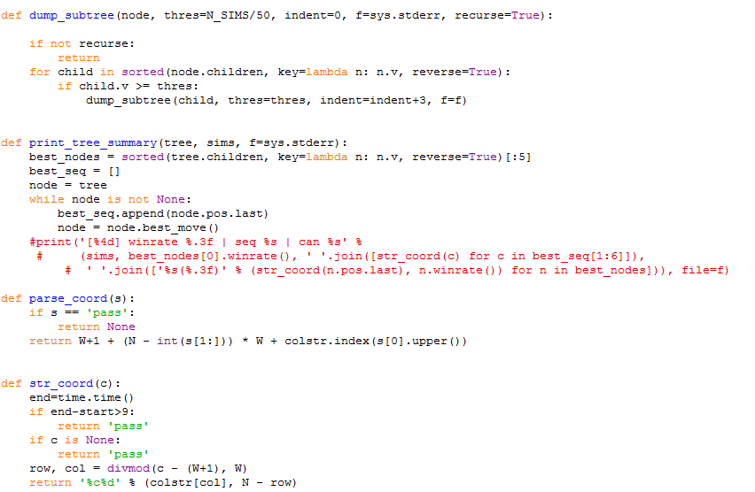
pemilihan tempat koordinat dan kondisi jika pass

Slide 33
Thank You

